Slide 1
Automating routine tasks for the SQL Server data professional
Andy Mallon

Slide 2

Andy Mallon
I sell furniture at the mall
Database Architect at Wayfair.com*
Working with SQL Server since 2003
Background in Tech Support, Database Administration, and Database Architecture
Lazy
Impatient
* The views & opinions expressed in this presentation are mine alone and do not reflect the views of my employer.

Slide 3


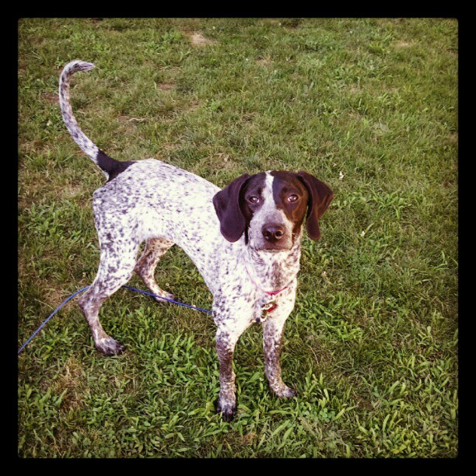
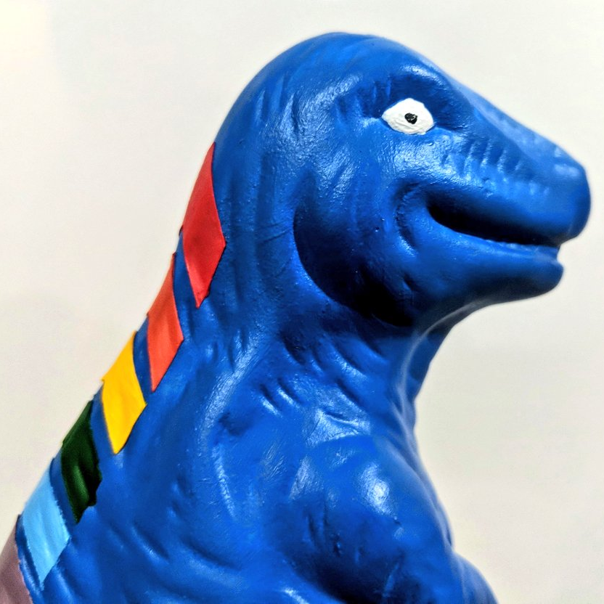
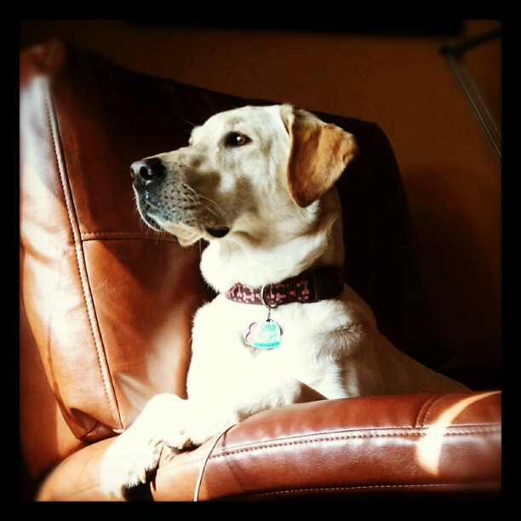

Notes:
Some of the things I love most in life– My husband, my pups, Queery the Diversity Dino.

Slide 4
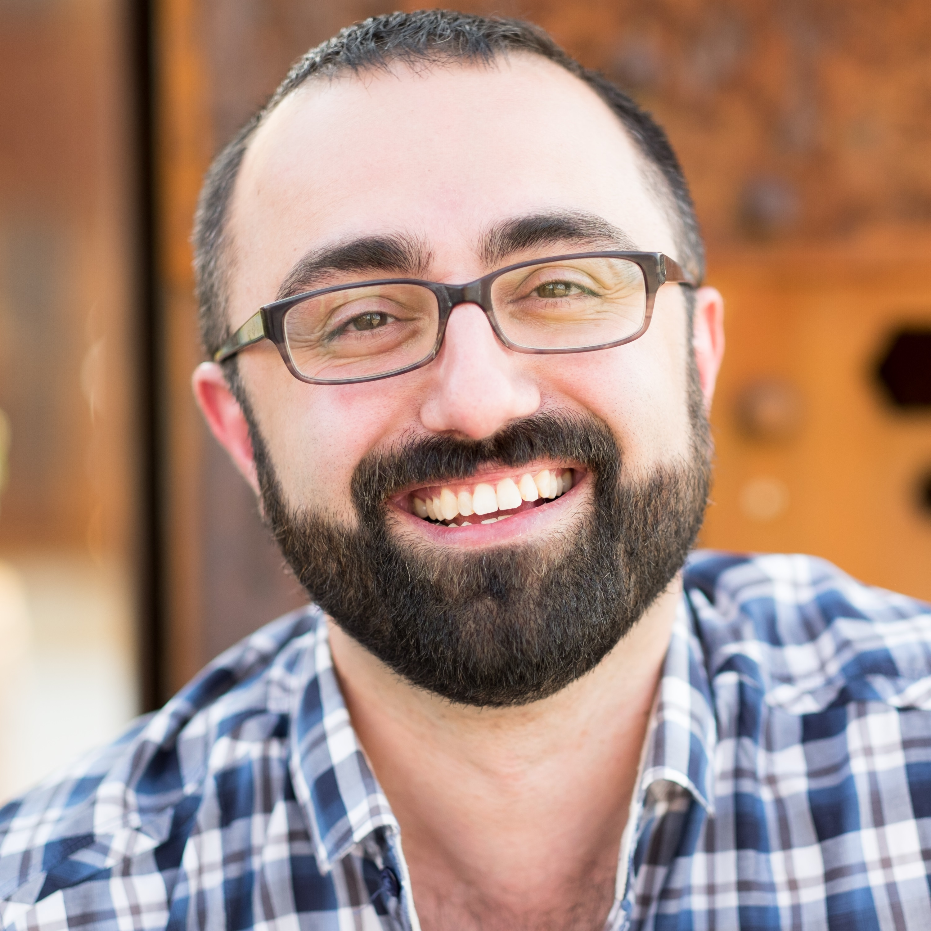


Contact Andy
Andy@AMtwo.co
@AMtwo
am2.co/shortcuts
andy@am2.co

Slide 5

Session Feedback
Tell me what you don’t like
Tell me what can be better
Tell me what you like

Slide 6

I'm also gonna need you to go ahead and silence your mobile phones
Yea…….You apparently didn’t put one of the new coversheets on your TPS reports.

Slide 7
What we’ll cover
Why automation is important
Identify tasks you should automate
Picking the right tool for the job
How I approach automation
Perform an install in one line of PowerShell

Slide 8
Before I start…
Who uses checklists?
Who has scripted those checklists?
Who is lazy?
Who is impatient?

Slide 9
Why is automation important?

Slide 10
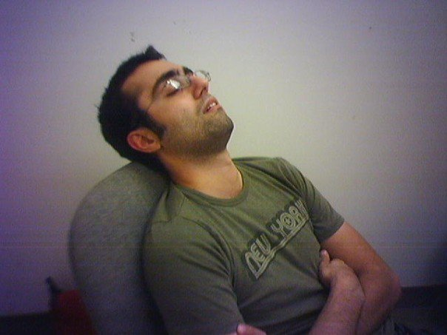
I’m lazy
Boring tasks are boring
Repetitive tasks are boring
I want to work smarter, not harder

Slide 11
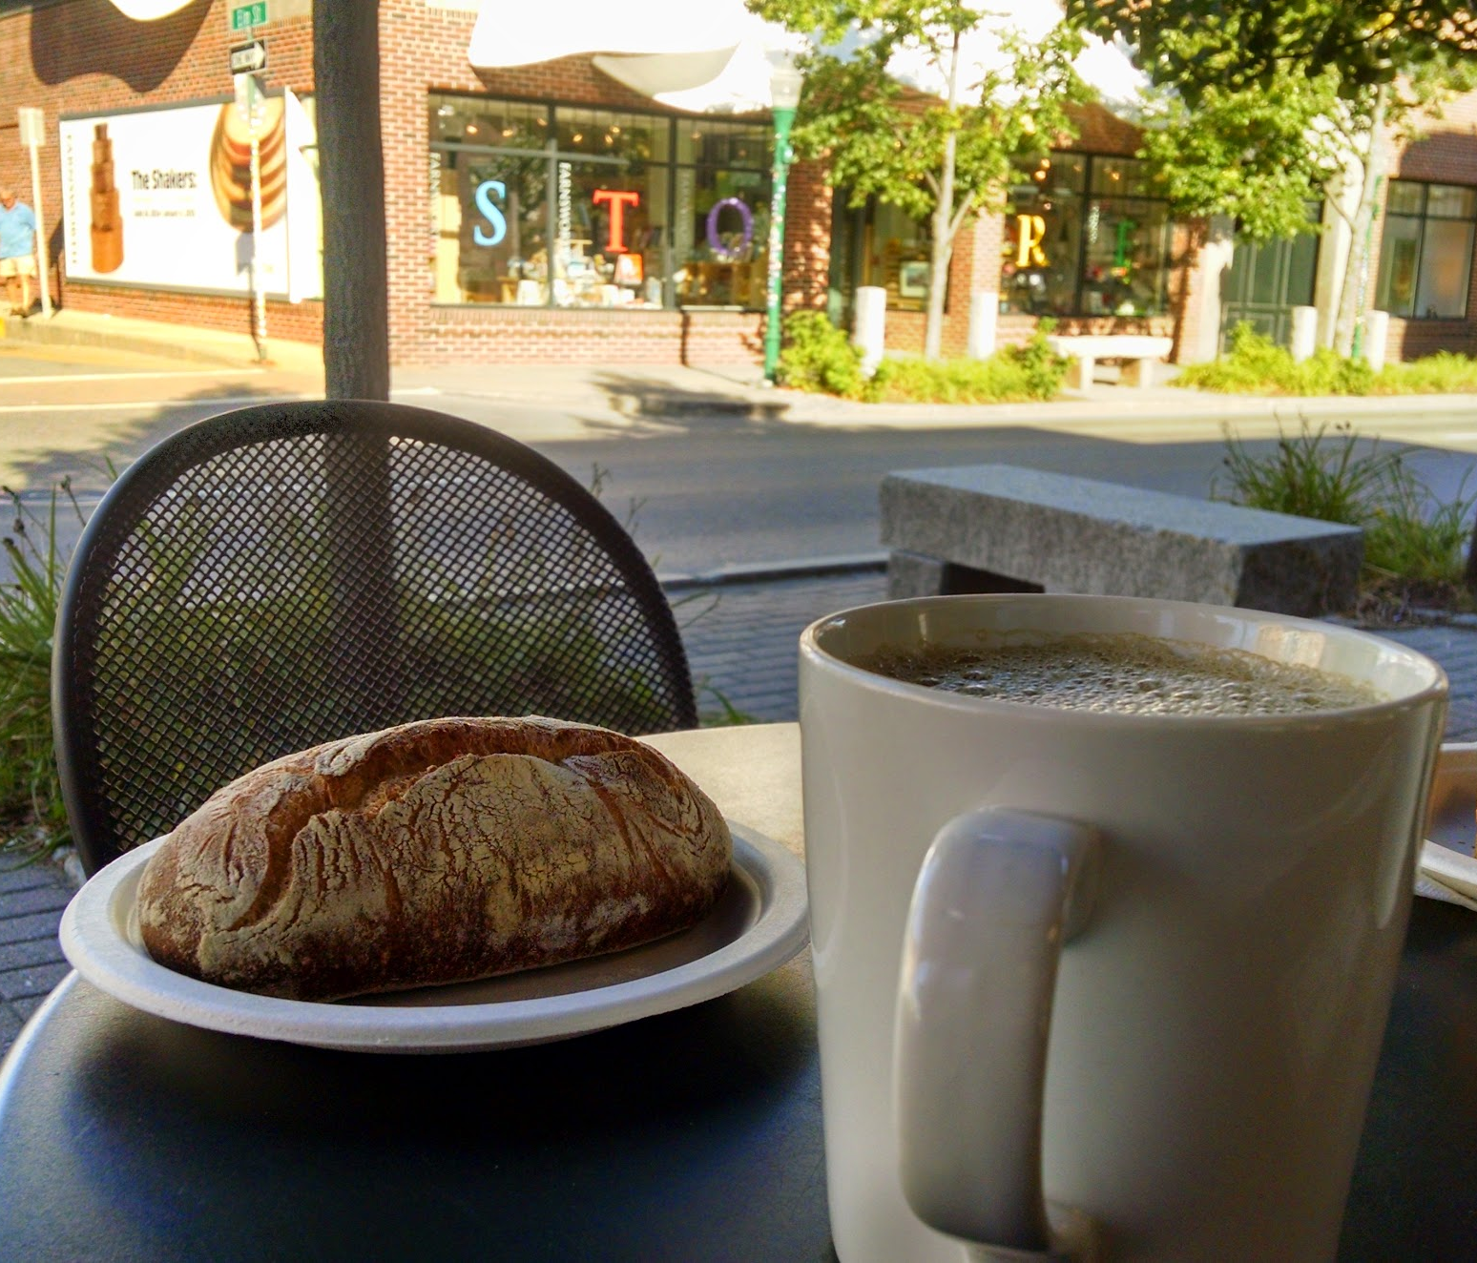
I’m busy
I have a lot of work to do
I like to relax on nights & weekends
I want to be bored

Slide 12
Busy is a four-letter word
Jes Borland – Session recording
https://am2.co/busy-is-a-four-letter-word
I want to be bored!

Slide 13
Checklists & Automation

Slide 14
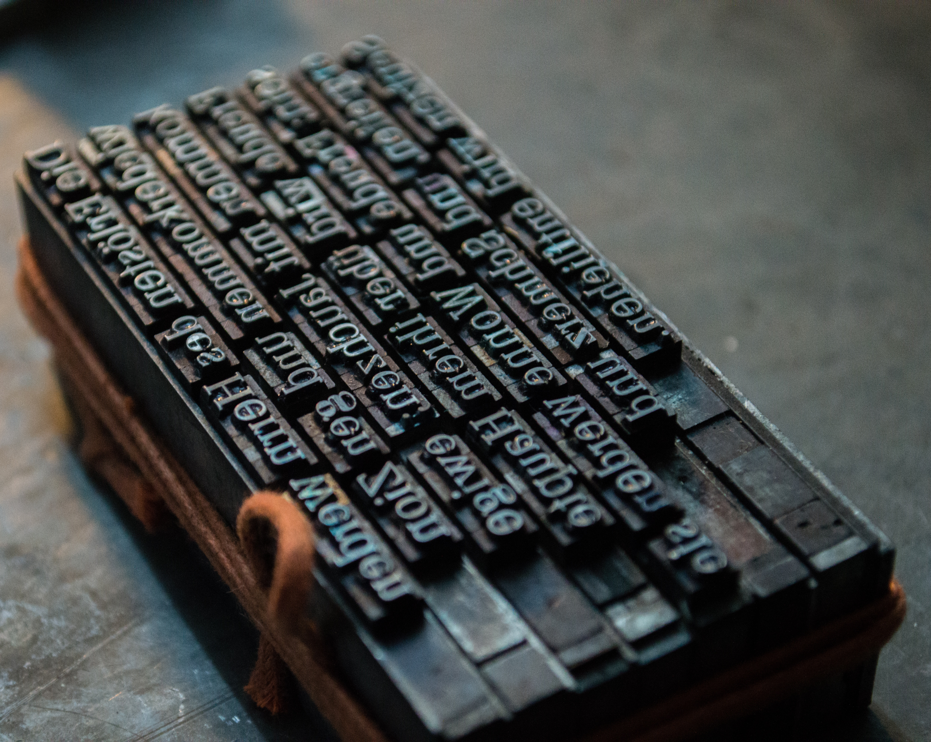
Consistency
Easier to troubleshoot problems
Easier to predict behavior

Slide 15
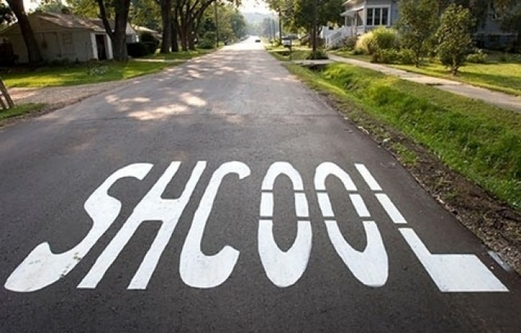
Consistency
Get things right every time
Get things wrong every time

Slide 16

The DBA is the Sheriff
We’re held accountable for the environment
Just because you can do something doesn’t mean you should
Learn to say “no”

Slide 17
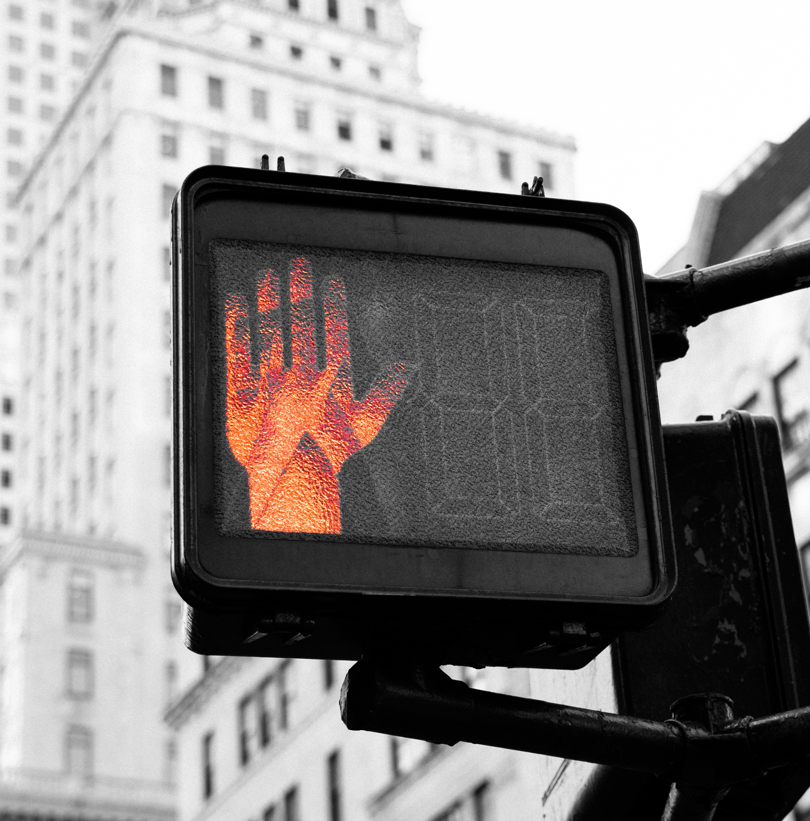
Learn to say “no”
You can’t do everything
You can do more if you automate things
But you can’t automate everything
So you can’t do everything
Be nice about it
Use “No” to start the conversation

Slide 18
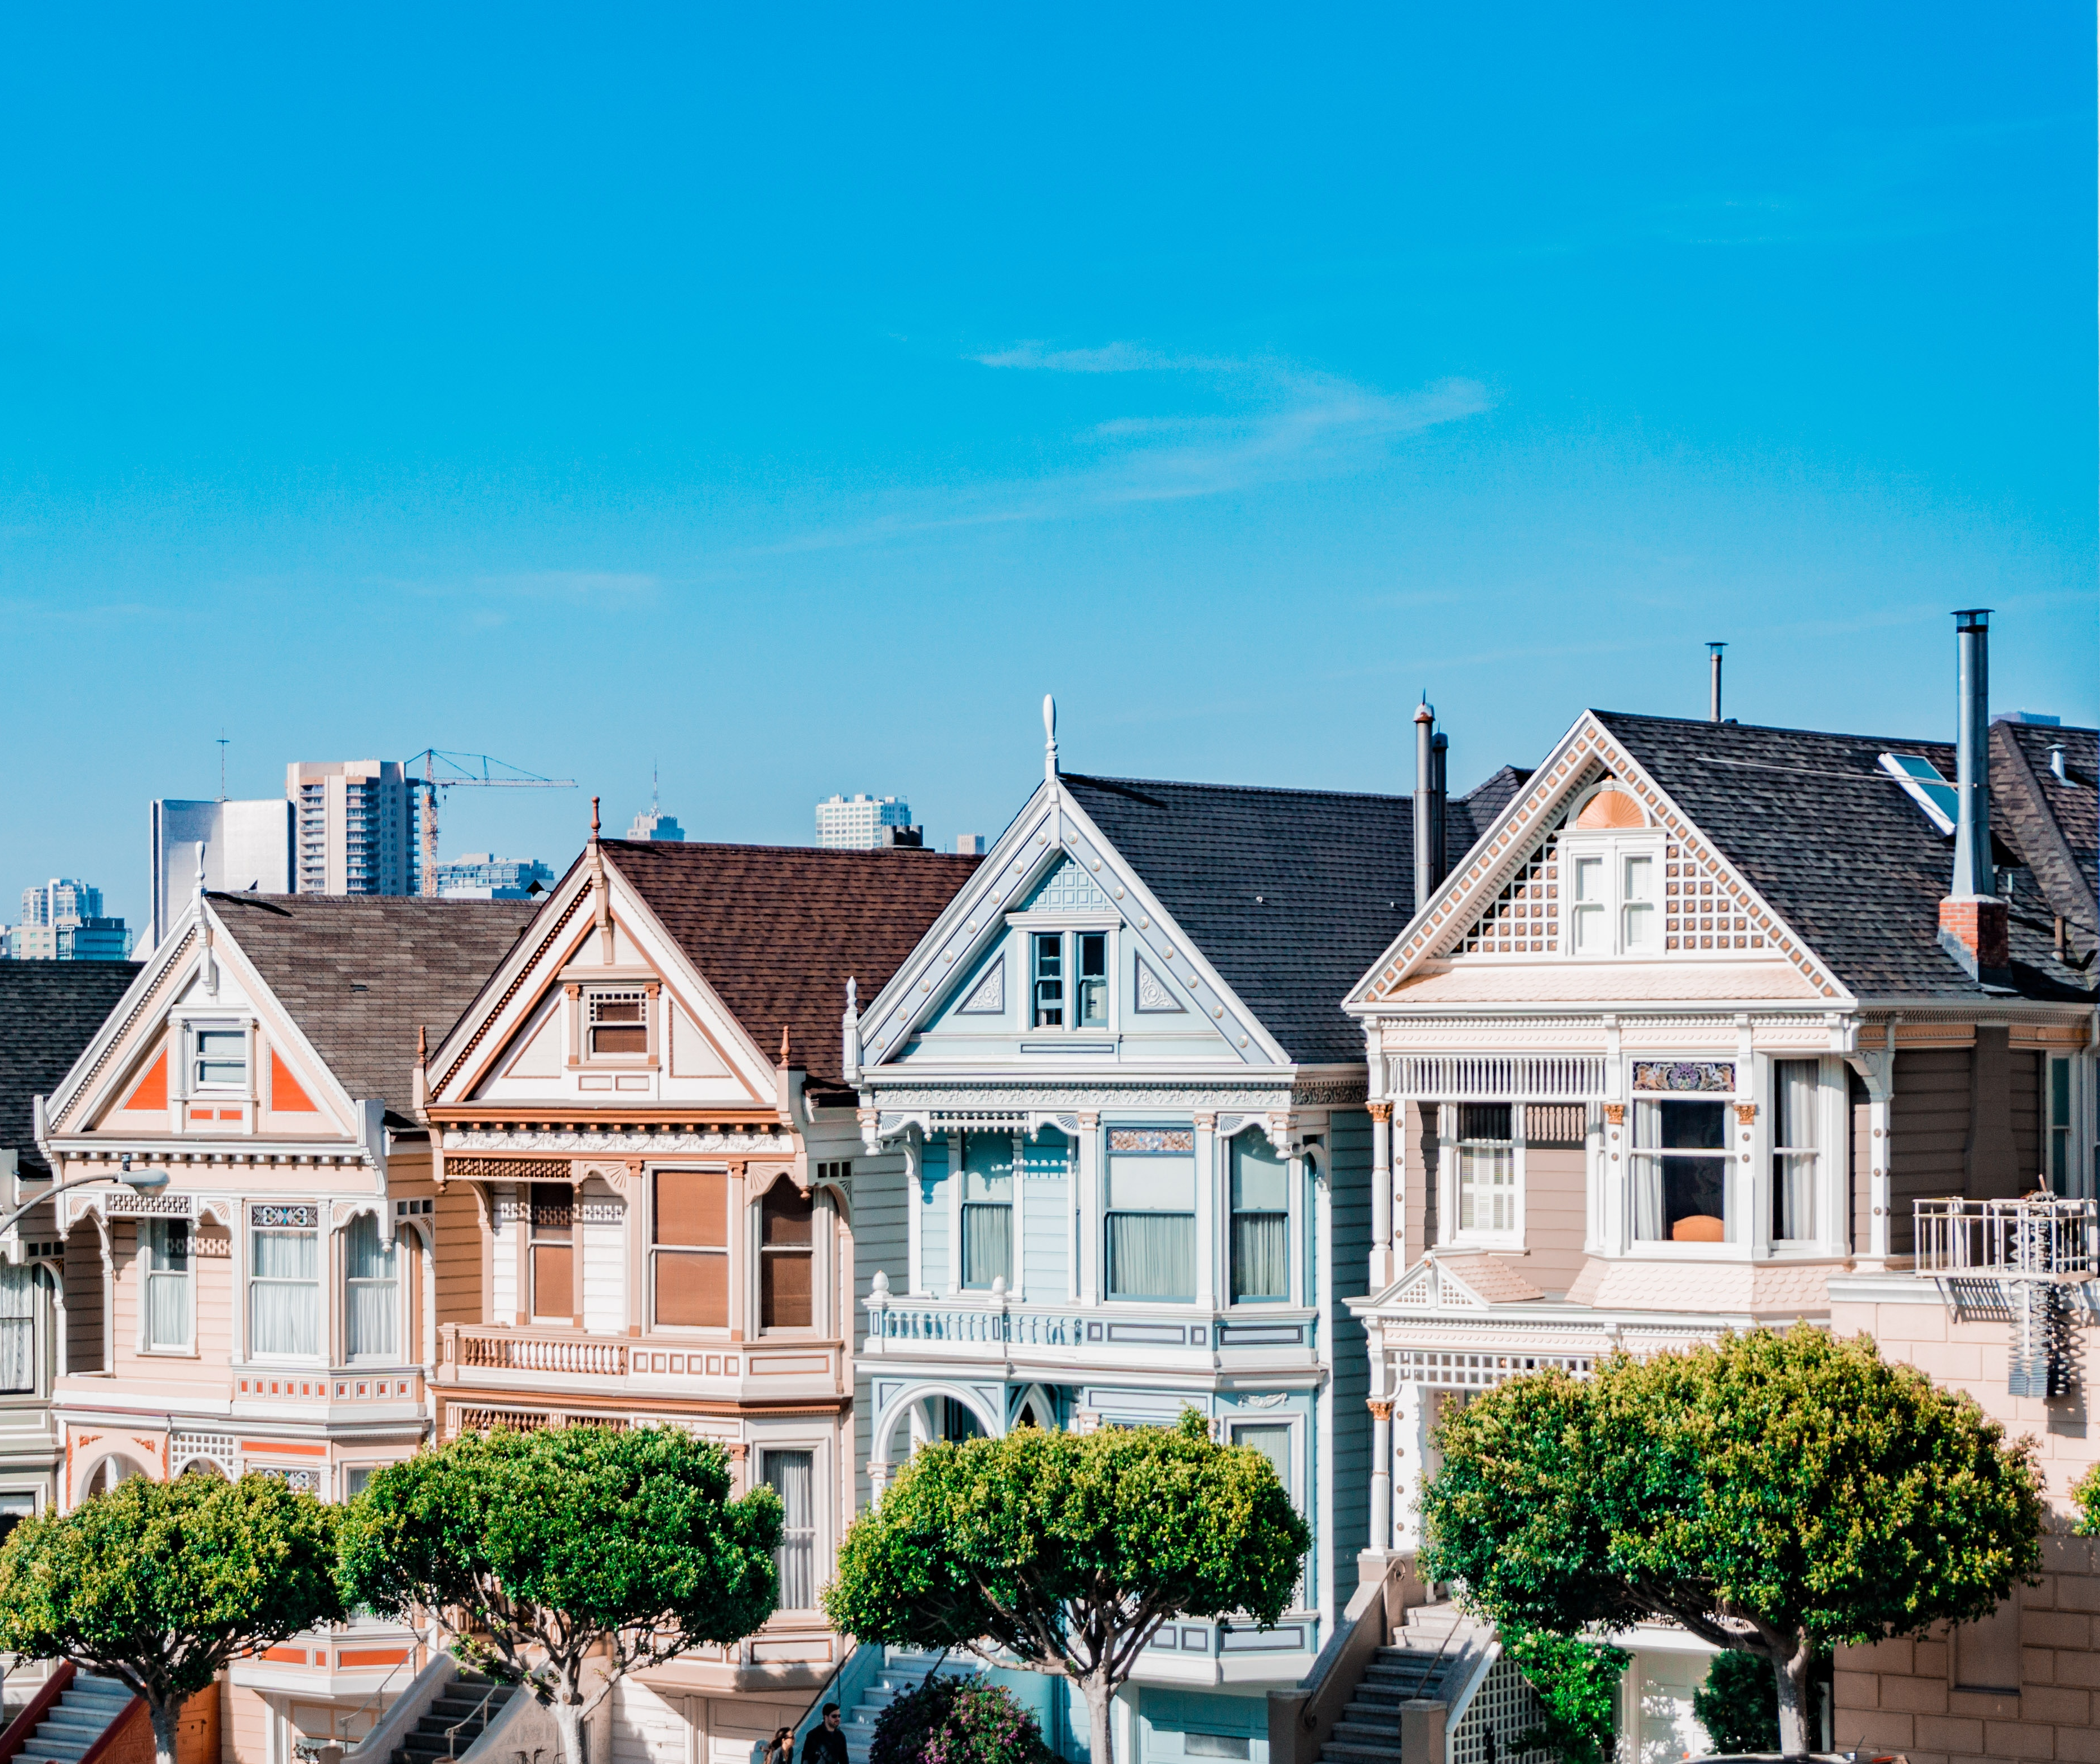
Standard build/config/process
The default
Everyone uses it unless they can’t
Basis for SLAs
You can have multiple “standards”

Slide 19

Exception build/config/process
Supported alternative
Known pitfalls
Maybe lessened SLAs

Slide 20
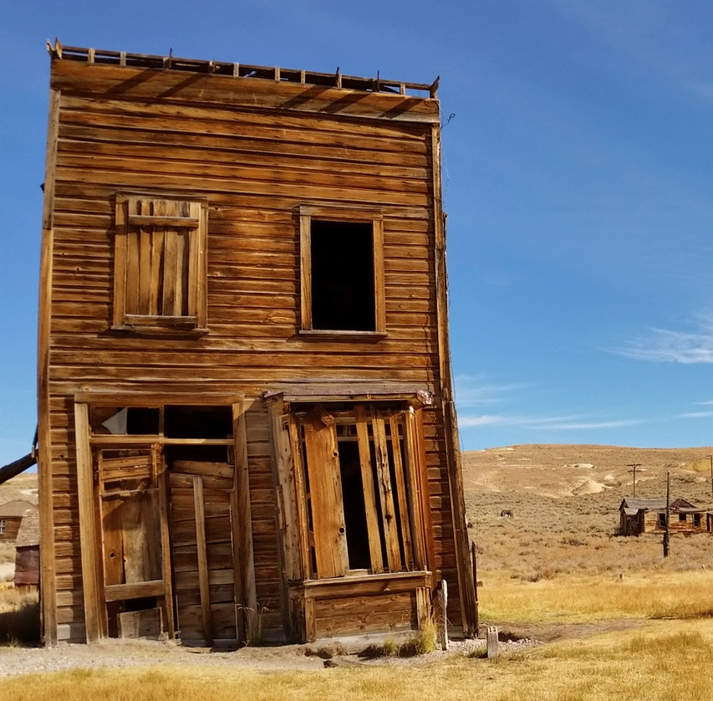
Prohibited build/config/process
Scenarios that aren’t allowed in your environment
Security
Industry Regulation
Lack of knowledge
Lack of money

Slide 21
Why automation?

Slide 22
Productivity
Do more faster
Less time on routine tasks
More time on unique tasks

Slide 23
Save time & money
Save on labor costs
Mitigate labor shortages
Increase your value to your employer

Slide 24
Improve quality
Humans make mistakes
Automation makes the same mistake repeatedly
Fixing automation fixes the error forever*
* For the specific case you coded a fix for. A different flavor of the problem might come back. Your fix is only as good as your code.

Slide 25
Improve transparency
Generate detailed logging
Make logs discoverable
Easier to research problems

Slide 26
Improve speed
Product releases are getting faster
Move faster without having to run
Faster results make happy customers

Slide 27
Standardization
Easier to identify problems
Easier to predict problems
Easier to prevent problems

Slide 28
What do I automate?

Slide 29
Don’t automate everything
Not everything can be automated
Not everything should be automated
Who is familiar with xkcd?

Slide 30
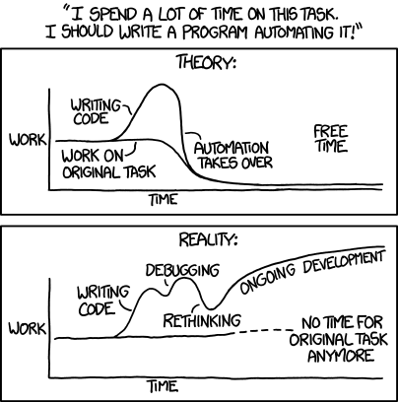
xkcd.com/1319 : Automation

Slide 31
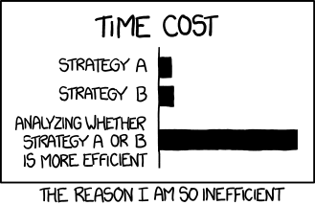
xkcd: Efficiency
xkcd.com/1445

Slide 32
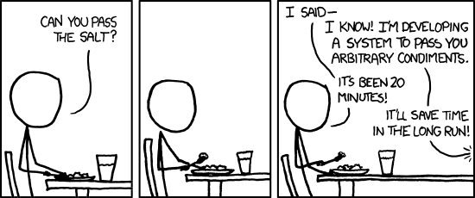
xkcd.com/974 : The general problem

Slide 33
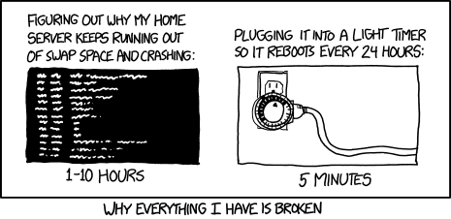
xkcd.com/1495 : Hard reboot

Slide 34
Fill in the blank
I have a ____________
and every once in a while it __________,
so I just ____________
because fixing this __________ is too hard.

Slide 35
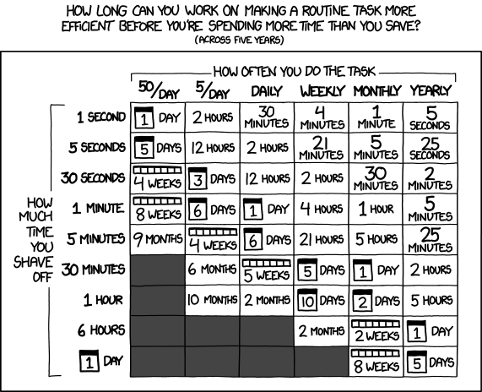
xkcd.com/1205 : Is it worth the time?

Slide 36
Picking the right tools

Slide 37
Some automation tools
T-SQL
PowerShell
Bash
SSIS
Python
.NET
Selenium
Jenkins
Puppet
Chef
Lambda functions
Azure Automation

Slide 38
Pick the right tool
T-SQL
PowerShell
Bash
SSIS
Python
.NET
Selenium
Jenkins
Puppet
Chef
Lambda functions
Azure Automation

Slide 39
Getting Started

Slide 40
Are you doing [task] already?
Develop a process
Develop a checklist
Start scripting individual steps
Save your scripts, stitch them together

Slide 41
SQL Install Automation

Slide 42
Install automation methods
ConfigurationFile.ini file
Setup.exe /param1 /param2
Both

Slide 43
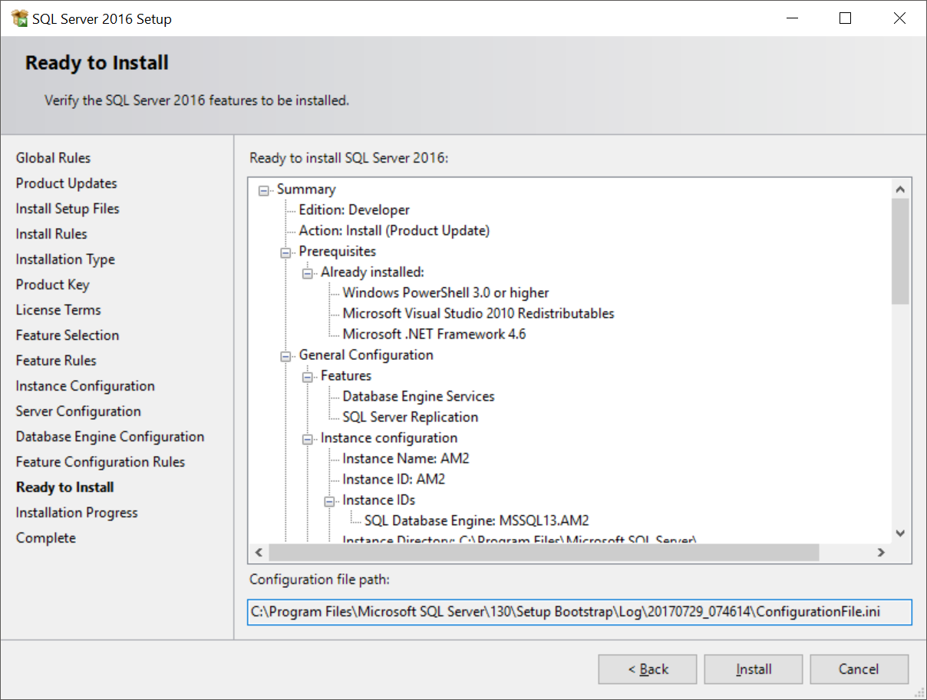
ConfigurationFile.ini

Slide 44
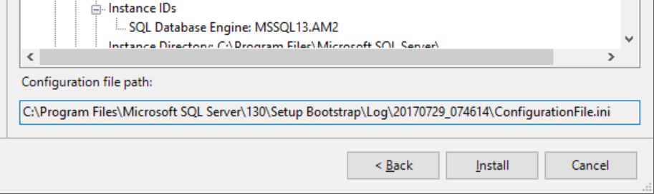
ConfigurationFile.ini

Slide 45
Demo

Slide 46
Questions?

